Slide 1
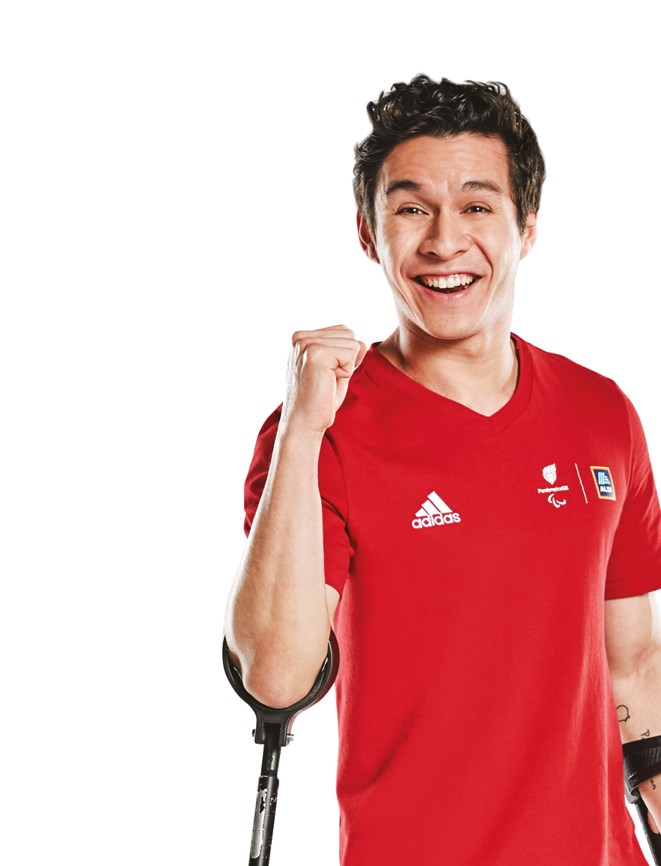
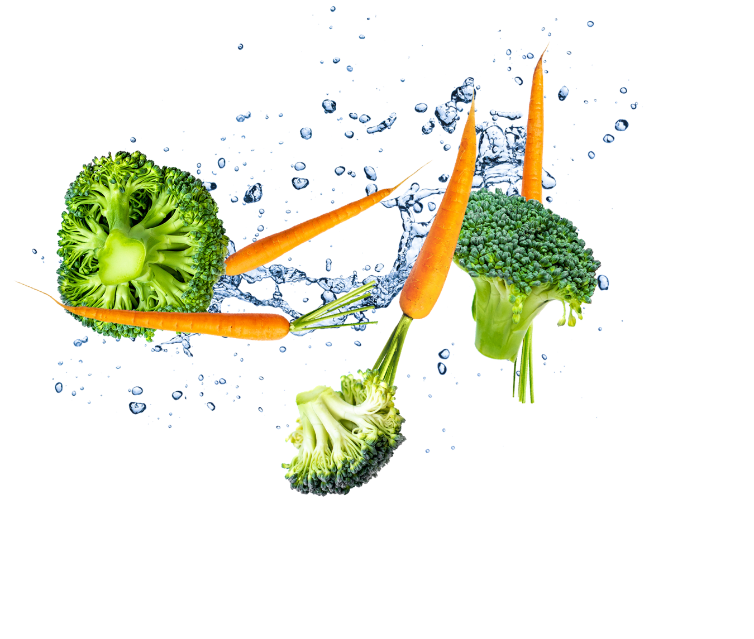
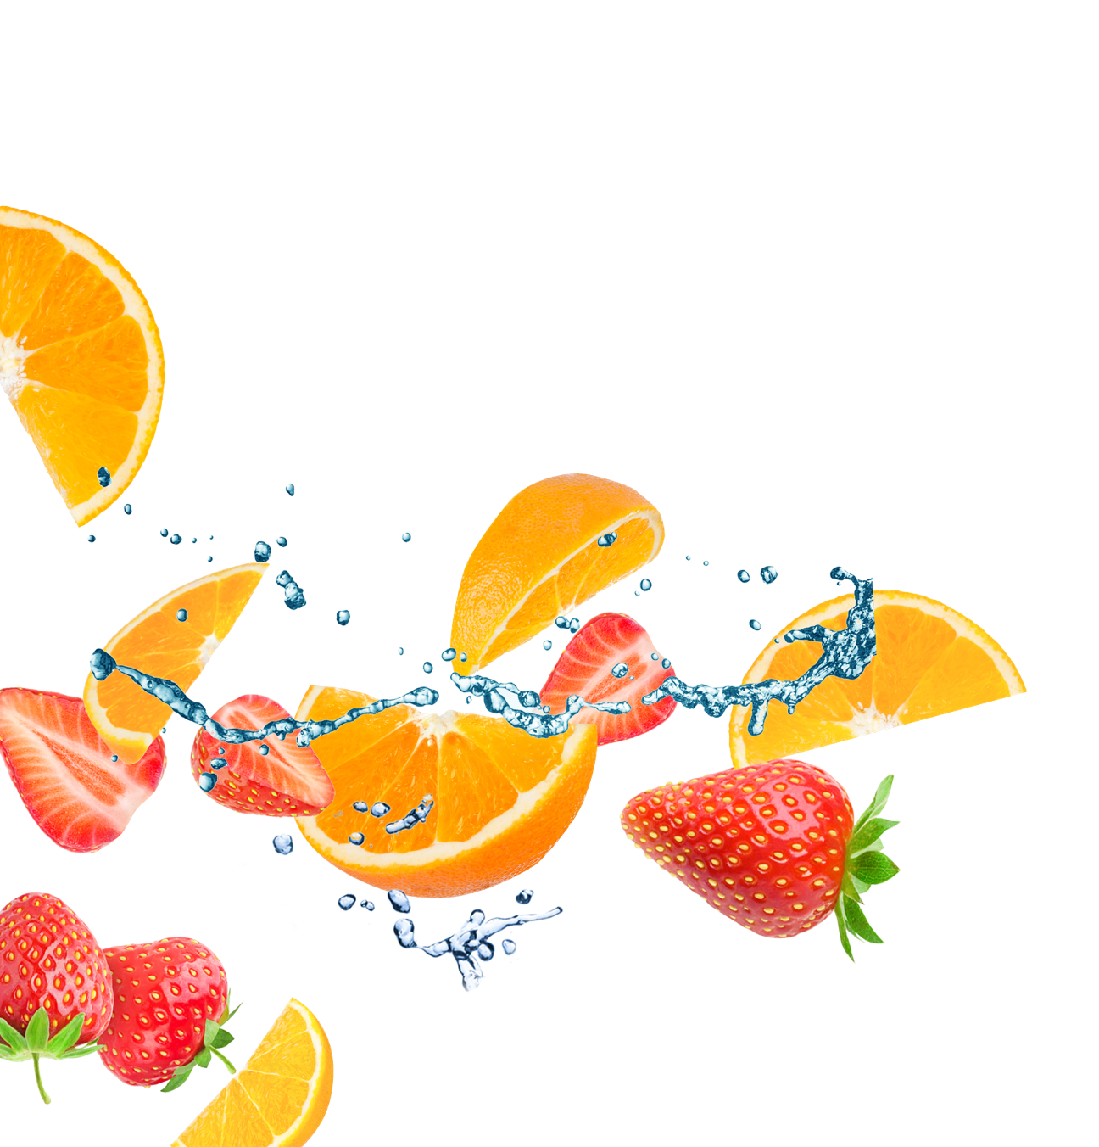
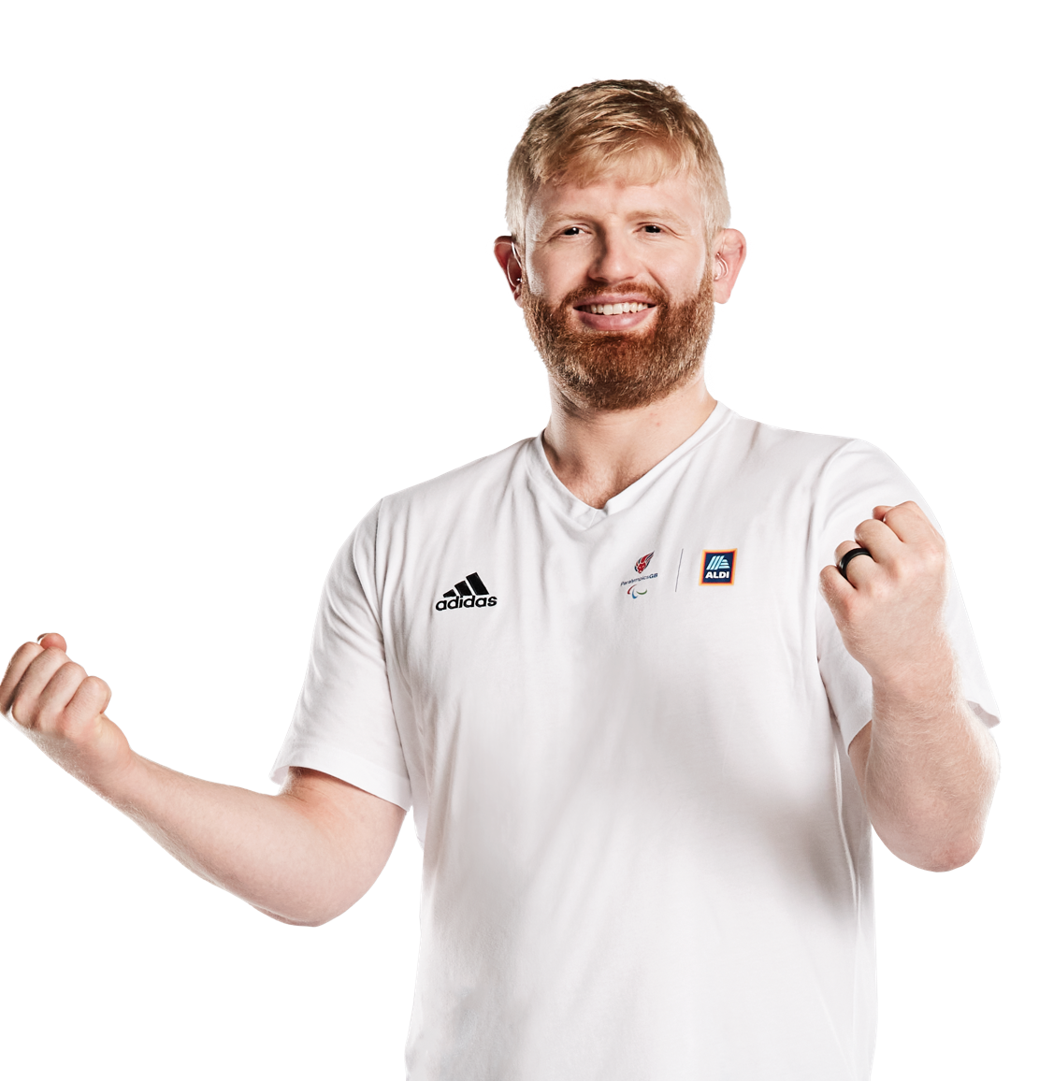
Design a Meal Competition

Slide 2


The competition
Design a healthy, balanced meal to fuel a Team GB or ParalympicsGB athlete at Paris 2024.
The best meal idea will receive £1,000 for their school and the chance to see Team GB in action with a family trip to the Paris 2024 Olympic Games!
Notes:
Introduction – the competition
Explain to students that they are going to explore what a healthy, balanced diet includes and design a healthy, tasty meal for a Team GB or ParalympicsGB athlete to enjoy. These meal designs will be entered into a competition and the top prize is to receive £1,000 for their school and the chance to see Team GB in action with a family trip to the Paris 2024 Olympic Games!
Watch the video as a class to find out more!
Further information:
The overall winner will receive an all-expenses paid trip to the Paris 2024 Olympic Games for a family of four (x2 double occupancy rooms), Friday 2 August–Sunday 4 August 2024. They will also receive £1,000 for their school, £100 Aldi vouchers and a Get Set to Eat Fresh goody bag.
Eight runners up (two from each of the following age groups, 5–7, 7–9, 9–11 and 11–14) will receive a Get Set to Eat Fresh goody bag (including a piece of signed Team GB/ParalympicsGB kit) and their entry will be displayed in the Get Set to Eat Fresh winners gallery.*
For further information on the competition, including entry materials and Terms and Conditions, please visit: getseteatfresh.co.uk/TBC
*Age groups refer to school years 1–2, 3–4, 5–6 and 7–9 in England/Wales or P1–2, 3–4, 5–6 and P7–S2 in Scotland.

Slide 3
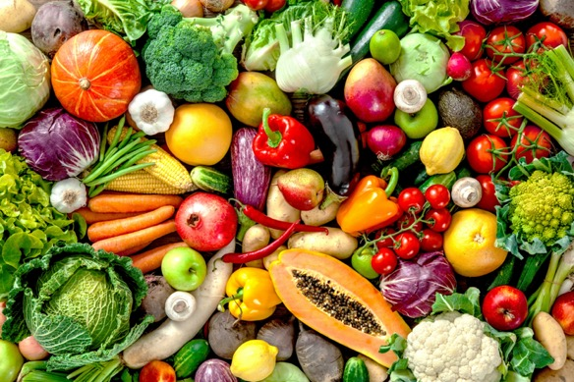
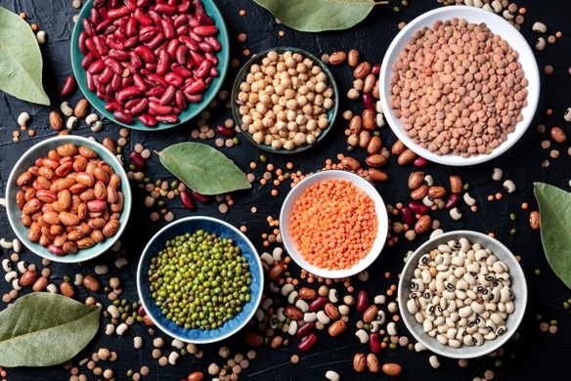
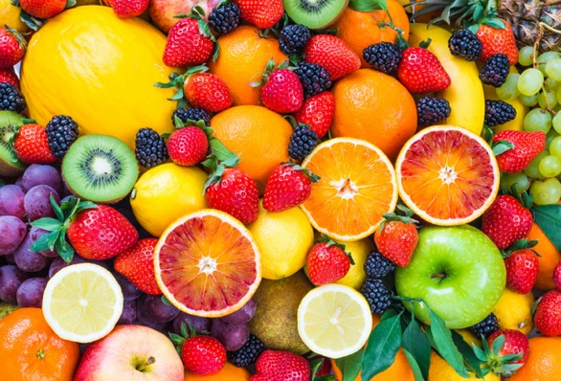
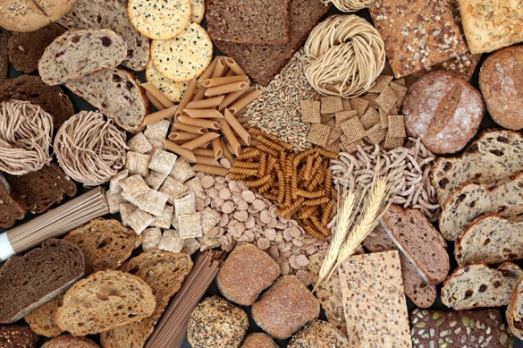
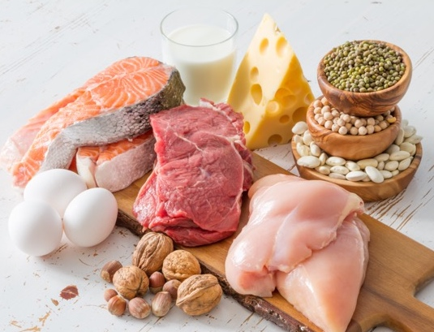
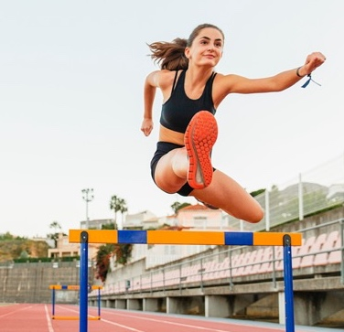
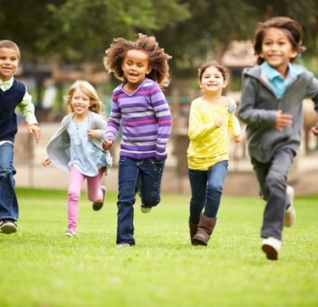
What does a healthy, balanced meal include?
Discuss with a partner or write 10 words.
Use these images to help you.
60
59
58
57
56
55
54
53
52
51
50
49
48
47
46
45
44
43
42
41
40
39
38
37
36
35
34
33
32
33
32
31
30
29
28
27
26
25
24
23
22
21
20
19
18
17
16
15
14
13
12
11
10
09
08
07
06
05
04
03
02
01
00
Notes:
Starter activity – 60 second discussion
Explain that this activity will help students to think about and understand the importance of eating a healthy and balanced diet. But first, what do they already know and think? This will help you to establish a baseline of what they know, and what support you may wish to give to help them design their meals.
Divide the class into pairs or small groups. Optionally, set a timer for 60 seconds (or your chosen time). Ask them to discuss as a think-pair-share activity, or write down ten words they think of and feel when they hear the phrase ‘healthy, balanced diet’.
What kinds of things did students think of? How did the phrase 'healthy, balanced diet', or the images on the slide, make them feel? Take some examples from the class and invite students to write popular responses/key ideas on the board, to generate their own word bank to refer to throughout the lesson. You could also use sticky notes on your wall, which allows ideas to be grouped into themes.
Support: Discuss the images on the board as a class and gather ideas for the word bank as you go through them. For example:
What do you think 'a healthy diet' means?
What do you think 'a balanced diet' means?
Fruit and vegetables – What are your favourite fruits and vegetables? What does it taste, look and feel like? Why do you like it? Are there any you don't like?
Pulses – Do you enjoy eating beans, chickpeas or lentils? What dishes do you eat them in? Do you know why they are healthy?
Meat and dairy – Do you eat meat, fish, or dairy? What meats or types of fish do you like? What does it taste like? Do you choose not to eat meat?
Whole grain foods – What starchy foods do you enjoy? How do you like to eat them? Do you prefer ;white' versions or brown/whole versions? Which do you think are healthier?
Athletes – Why do you think an athlete needs to eat a healthy diet? Do you think athletes need to eat the same foods as you? Do you think they need to eat as much?
Healthy, active children – Why do you think you also need to eat a healthy diet? What do you think a healthy diet will help you to do and be?
Challenge: Ask students to complete the activity individually, then to swap their ideas or word list with the person next to them. They should try to add detail to some of their partner’s ideas – adding connecting words or feelings, before swapping back and sharing with the class on the board.

Slide 4
True or false?
Test your knowledge of a healthy, balanced diet.
We should eat lots of different fruit
and vegetables each day.
Protein is only found in meat and fish.
True
True
False
True
False
False
True! To make sure we get all the vitamins
and minerals we need, we should eat at least five portions of colourful fresh, frozen, canned,
dried or juiced fruit and vegetables a day.
False! Beans, pulses, nuts, eggs and dairy products are also great sources of protein – and they’re vegetarian or vegan!
Notes:
Activity 1 – Quiz: What do you know about a healthy, balanced diet?
Take the class quiz to help students understand or review key facts about healthy, sustainable food. To make the game more active, ask students to perform an action, such as jumps for true, and squats for false.
True or False: We should eat lots of different fruit and vegetables a day.
True! To make sure we get all the vitamins and minerals we need, we should eat at least five portions of fresh, frozen, canned, dried or juiced fruit and vegetables a day. Vitamins and minerals help keep our bodies healthy and can help us process other nutrients that the body needs. Thinking about eating a range of different coloured fruits and vegetables can help us eat a balance of different vitamins and minerals!
2. True or False: Protein is only found in meat and fish.
False! Beans, pulses, nuts, eggs and dairy products are also great sources of protein – and they’re vegetarian or vegan! Protein is important because we use it to grow (create new cells) and repair (mend damaged cells) our bodies.
Support: Give students hints from the answer or visual clues to help them figure out the correct answer
Challenge: Ask pupils to explain why they have selected true or false. Explain that other pupils can change their minds if a student makes a compelling argument.
Further information
Q: How many portions of fruit and vegetables should we eat a day?
A: At least five.
Q: What counts as a portion of fruit and vegetables?
A: The exact portion changes for each fruit and vegetable, but it is roughly the same as what fits in the palm of your hand.
To explore portion size more fully, trying measuring out some portions using the rules below:
80g of any of these: one apple, banana, pear, orange or other similar-size fruit
three heaped tablespoons of vegetables
a dessert bowl of salad
30g of dried fruit (which should be kept to mealtimes)
or a 150ml glass of fruit juice or smoothie (counts as a maximum of one portion a day).
Ensure students understand that fruit and vegetables should be eaten as part of a balanced diet, making up a third of what we eat every day.
SOURCES
Eatwell guide: assets.publishing.service.gov.uk/government/uploads/system/uploads/attachment_data/file/742750/Eatwell_Guide_booklet_2018v4.pdf

Slide 5
True or false?
Test your knowledge of a healthy, balanced diet.
White pasta helps you feel fuller for
longer than wholewheat pasta.
We all need a little fat in our diet.
True
False
False
True
True
False
False! Wholegrain carbohydrates like wholewheat pasta, potatoes with the skins on, or brown rice have more fibre and can help you stay fuller for longer.
True! Stick to healthier, unsaturated fats from plant sources like vegetable oil, rapeseed oil and olive oil.
Notes:
Activity 1 – Quiz: What do you know about a healthy, balanced diet?
1. True or False: White pasta can help you feel fuller for longer than wholewheat pasta.
False! About a third of what you eat should be starchy carbohydrates, like potatoes, bread, rice, pasta and cereals. Varieties with more fibre – such as wholegrain pasta, potatoes with the skins on, or brown rice – can help you stay fuller for longer.
2. True or False: Eating some fat is an important part of a balanced diet.
True! Stick to healthier, unsaturated fats from plant sources like vegetable oil, rapeseed oil and olive oil. But we only need a little fat as it contains a lot of energy.

Slide 6
True or false?
Test your knowledge of a healthy, balanced diet.
We should try to eat the same
meals most of the time.
Sugary foods are a great source
of long-lasting energy.
True
False
False
True
False
False
False! The best diet is varied and includes many different fruits and vegetables each day and different wholegrain carbohydrates and sources of protein.
False! Sugary foods can give you a quick, short burst of energy, but other carbohydrates especially
wholewheat pasta, brown rice or potatoes with
the skins on, are better for long-lasting energy.
Notes:
Activity 1 – Quiz: What do you know about a healthy, balanced diet?
We should try to eat the same meals most of the time.
False! The best diet is varied and includes many different fruits and vegetables each day and different wholegrain carbohydrates and sources of protein. While we all have our favourite meals, if we don't get enough variety in our diet we will miss out on essential vitamins and minerals, for example.
2. Sugary foods are a great source of long-lasting energy.
False! Sugary foods can give you a quick, short burst of energy, but other carbohydrates especially wholewheat pasta, brown rice or potatoes with the skins on, are better for long-lasting energy, for example if eating dinner to prepare for a busy, active day (or for an athlete eating the night before a day or training or competition)! Note that we can all enjoy some sugary foods as part of a balanced diet – but should eat fewer of these than other kinds of foods! (Eating too many sugary foods like sweets and fizzy drinks can also cause tooth decay and lead to other health problems.)
For more information on a balanced diet please see the parent take-home guide.

Slide 7
True or false?
Test your knowledge of a healthy, balanced diet.
We should all drink 6–8
glasses of water a day.
We all need the same amount
of energy from our food.
True
True
False
True
False
False
True! Staying hydrated helps keep us focused
and healthy. We need about 6–8 glasses of water, low-fat milk or other low-sugar drinks each day – or more if we're sweating from getting active!
False! Some people need more energy than others, like growing children or athletes in training every day – but we all need a balance of different foods!
Notes:
Activity 1 – Quiz: What do you know about a healthy, balanced diet?
We should all drink 6–8 glasses of water a day.
True! Keeping ourselves hydrated is important for our bodies, helping us stay active, regulating our temperature and helping our brain to function. We should aim for 6–8 glasses of water, low-fat milk or other low-sugar drinks each day, or more if we're sweating from getting active, or if the weather is hot!
2. We all need the same amount of energy from our food.
False! Some people need more energy than others, like growing children or Team GB and ParalympicsGB athletes who train hard every day vs an adult who works in an office and doesn't get the chance to move a lot. Our energy needs depend on our age and activity level (and our metabolisms). It's important that we consume the energy we need for our activity levels and bodies – but everyone needs a balance of different foods!

Slide 8
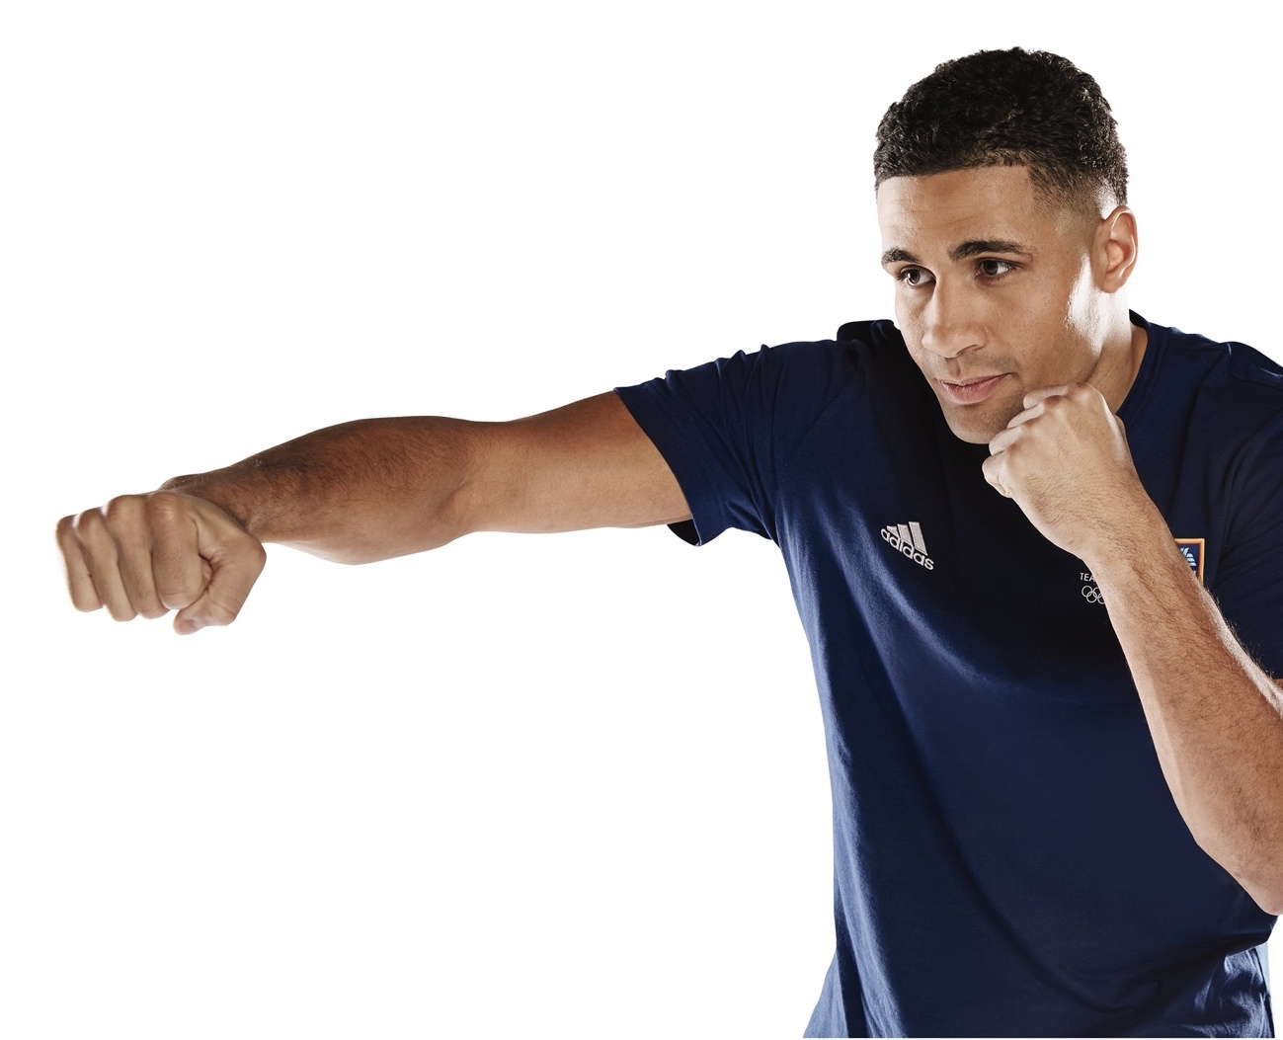
Why do athletes need healthy, balanced meals?
A healthy, balanced diet helps us all to stay healthy!
How would you define a healthy, balanced diet?
Why do you think a healthy diet is important for Team GB and ParalympicsGB athletes?
How might a healthy diet for an athlete
be similar and different to a healthy
diet for an adult that works in an office?
getseteatfresh.co.uk | #GetSetEatFresh
Notes:
Activity 2 – Why do athletes need healthy, balanced meals?
Emphasise that everyone should aim to enjoy a healthy, balanced diet that gives them all the nutrients they need, and the right amount of energy.
This discussion activity helps students to appreciate how good nutrition helps athletes to train and perform at their best.
Class discussion: Discuss each question one by one as a whole class.
Think-Pair-Share: Students think of their own responses, then discuss with a partner and then share as a class.
Snowball: Students discuss in pairs then join with another pair to discuss their ideas.
Support: Ask students to imagine what an athlete's day might be like. Help them to understand that athletes are much more active than the average person. This means that while they also need to eat a healthy diet, they will need more energy (which means, for example, eating more healthy carbohydrates) and they may need more protein to help build their muscles and repair their bodies.
Suggested answers:
Draw together students' knowledge. Emphasise that a healthy diet is all about balance – eating a variety of the foods groups (carbohydrates, proteins, vitamins and minerals, dairy or alternatives, oils and fats) and an amount of food that best suits your activity levels. A healthy diet also means hydrating yourself well!
A healthy diet that's full of nutrients and energy helps athletes to train and perform at their very best, for example growing and repairing their muscles to be stronger or faster, and fuelling long days of training.
An athlete's diet might look the same because it includes a balance of nutrients – packed with fruits and vegetables, healthy carbohydrates and enough protein and fats. An athlete might need to eat differently because they need lots more energy (so they might eat more healthy carbohydrates), and extra protein for growth and repair (so they may eat more healthy forms of protein).
Challenge: Prompt students to start thinking about what foods athletes might need at different times of day and if different athletes might have different needs?

Slide 9
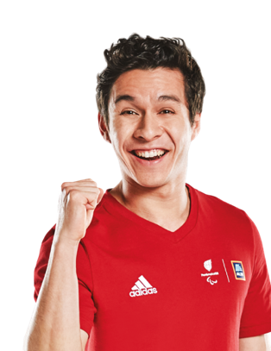
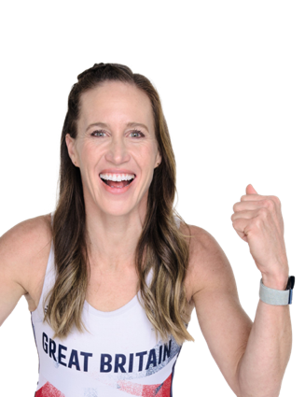
Design a healthy, balanced meal to fuel a Team GB or ParalympicsGB athlete at Paris 2024.
Choose one of our Team GB or ParalympicsGB Aldi Athlete Ambassadors.
Read about what they like and need
to eat to help them train and compete.
Design a healthy, balanced and
tasty meal for them to enjoy.
Complete an entry template to tell
us about your meal!
Did you know?
13 million meals will be needed to feed the athletes, their teams and the fans at Paris 2024!
Notes:
Activity 2 – the competition
Recap the main elements of the competition.
Students' first task will be to choose which Team GB or ParalympicsGB athlete they will help! The next slides introduce some of our Athlete Ambassadors and give some simple facts about what they need (and like!) to eat.

Slide 10


Meet the athletes
Helen Glover
Rowing
My favourite vegetables are carrots and spinach.
I need lots of energy before I compete.
My dad owns an
ice-cream shop in my hometown in Cornwall!
Oliver Lam-Watson
Wheelchair Fencing
My favourite vegetables are aubergines and radishes!
I need lots and vitamins and minerals – and fruits and water to stay hydrated when it gets sweaty in my fencing gear!
I love Japanese food – especially sushi.
Notes:
Review each athlete together. You may wish to print and cut up copies of each slide, to give each student the information they need to start planning and designing their healthy meal.
Support: focus on the simpler profiles, or simplify the later profiles – focus pupils on the athlete0’s favourite foods and the shared need for lots of energy!
Challenge: help students pull out differences between athletes' diets and average adult diets (i.e. may need more carbs and protein, depending on the sport), and differences between sports.

Slide 11
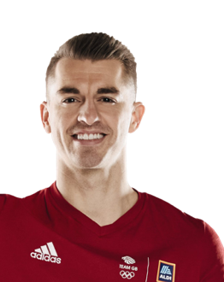
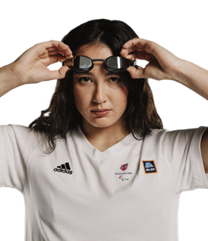
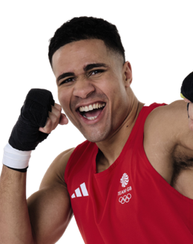
Meet the athletes
Max Whitlock
Gymnastics
My favourite
breakfast is toast,
eggs and salmon.
Pasta with meat and vegetables gives me the fuel I need.
On a rest day I love to share a pizza with my family.
Alice Tai
Para
Swimming
I'm vegetarian, so eat foods like beans and lentils for protein.
My go-to meal is lentil pasta with lots
of vegetables.
When I compete, I want to eat foods
I know so I don’t get sick.
Delicious Orie
Boxing
I need lots of protein
to recover after training
and stay strong.
I love porridge, scrambled eggs on toast and avocados.
For dinner I like rice, chicken or salmon and lots of vegetables!
getseteatfresh.co.uk | #GetSetEatFresh
Notes:
Review each athlete together. You may wish to print and cut up copies of each slide, to give each student the information they need to start planning and designing their healthy meal.
Support: focus on the simpler profiles, or simplify the later profiles – focus pupils on the athletes' favourite foods and the shared need for lots of energy! A reduced version of the profiles is provided as a printable slide (slide X) to support students.
Challenge: help students pull out differences between athletes' diets and average adult diets (i.e. may need more carbs and protein, depending on the sport), and differences between sports.

Slide 12
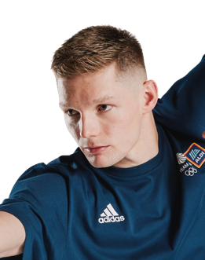
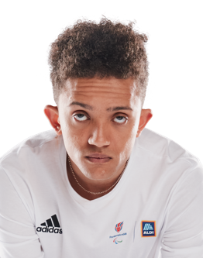
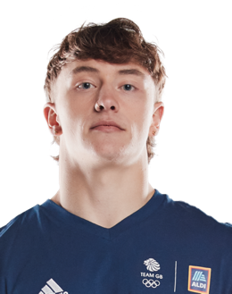
Meet the athletes
Duncan Scott
Swimming
I need lots of protein and
carbs – my grow and go foods!
I bulk make meals, like a big lasagna, to prepare for the week.
I like ginger shots and beetroot juice – they are full of vitamins!
Thomas
Young
Para Athletics
I love broccoli, but I'm allergic
to cheese!
In the morning, I like cereal, a fish sandwich and some fruit.
Before competitions I have foods like chicken, rice and vegetables.
Kieran Reilly
Freestyle BMX
I need extra carbohydrates
before long training days.
Before competing, I eat a lighter meal, so I don’t feel too full.
I love Mexican food, like a burrito bowl!
getseteatfresh.co.uk | #GetSetEatFresh
Notes:
Review each athlete together. You may wish to print and cut up copies of each slide, to give each student the information they need to start planning and designing their healthy meal.
Support: focus on the simpler profiles, or simplify the later profiles – focus pupils on the athletes' favourite foods and the shared need for lots of energy!
Challenge: help students pull out differences between athletes' diets and average adult diets (i.e. may need more carbs and protein, depending on the sport), and differences between sports. For example, speed / aerobic based sports may want lighter meals / snacks before competing and larger meals in the evening (looking for quick or slow-release carbohydrates), whilst strength athlete Emily Campbell needs fuller meals throughout the day).

Slide 13
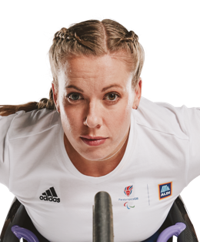
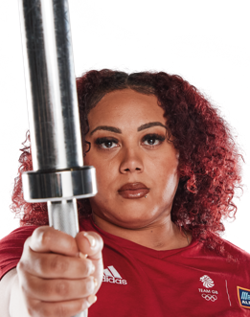
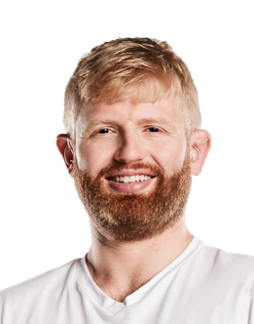
Meet the athletes
Emily Campbell
Weightlifting
I need to eat a lot of
food to stay as strong
as possible.
I love cooking and enjoy a varied diet.
In an example day I might have eggs, yoghurt, granola and fruit in the morning, a stir fry with teriyaki sauce for lunch, then chicken burger, sweet potato fries and broccoli, or chicken, mac and cheese, rice and plantain with
corn and coleslaw for dinner.
Chris Skelley
Para Judo
I'm coeliac, so need to
be gluten-free.
I make sure each meal includes carbs, vegetables and meat to fuel me for training or competing.
I like overnight oats with fruit and yoghurt on the day I compete, as I can feel a bit sick when I'm nervous.
Hannah
Cockcroft
Para Athletics
I eat everything except fish! My go-to pre-race meal is spaghetti bolognese, but on rest days I love a curry.
My golden rule is 'everything in moderation' – I train hard for my events (I compete in both sprint and middle-distance races), so if I fancy some cake, I'll have it!
It's always important to stay hydrated – it's simple but is easy to forget!
getseteatfresh.co.uk | #GetSetEatFresh
Notes:
Review each athlete together. You may wish to print and cut up copies of each slide, to give each student the information they need to start planning and designing their healthy meal.
Support: focus on the simpler profiles, or simplify the later profiles – focus pupils on the athletes’ favourite foods and the shared need for lots of energy!
Challenge: help students pull out differences between athletes’ diets and average adult diets (i.e. may need more carbs and protein, depending on the sport), and differences between sports. For example, speed / aerobic based sports may want lighter meals / snacks before competing and larger meals in the evening (looking for quick or slow-release carbohydrates), whilst strength athlete Emily Campbell needs fuller meals throughout the day – requiring around 3,300 calories per day, compared to the average adult female who needs about 2,000 calories per day).

Slide 14
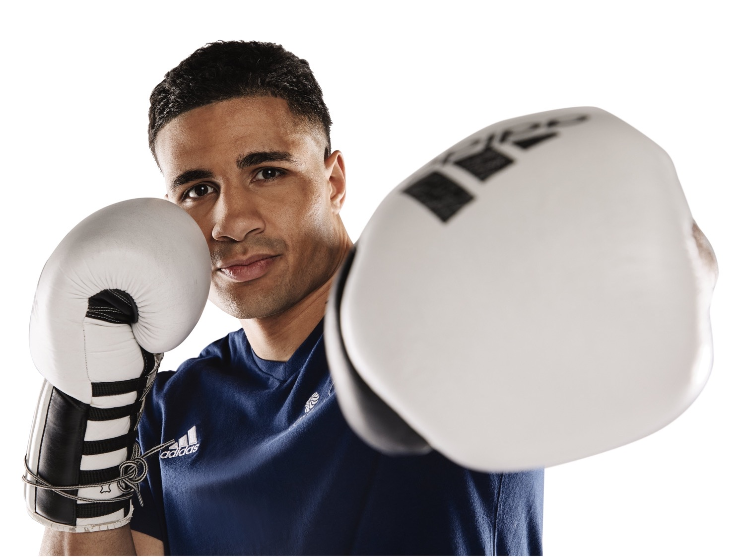
Think about what your athlete needs
Can you imagine what it's like to train and compete in this sport?
When will your athlete eat
your meal?
How will it help them to feel good and perform at their best?
getseteatfresh.co.uk | #GetSetEatFresh
Notes:
Activity 3 – How can we create a healthy meal?
This final activity helps students to plan how they will design a healthy, balanced meal and create a strong entry to our competition. You may wish to give students a copy of the entry template as you discuss each step. Students may also want to make notes of their ideas on some blank or scrap paper.
Discuss each question as a class or guide students to reflect individually or with a partner. Students could make notes to remind them when they complete their entry template.
Support: Students could mime or imagine the movements their athlete might make. Do they need to be fast? Strong? Both? Where might they need to train for this sport? Ask students to choose whether they will design a breakfast, lunch (which may need to be a packed lunch to eat at a training ground) or evening meal. Remind students to read what their athlete needs and likes.
Use these questions to help students start to build their meal:
Will their meal be a breakfast, lunch or evening meal?
What healthy carbohydrates will they include? (Wholemeal pasta or bread, potatoes or sweet potatoes with the skin on, brown rice etc.)
What source of protein will they include? (Meat, fish, eggs, beans and pulses, tofu etc.)
What vegetables will they include (Encourage students to include at least three of different colours, including a green vegetable like broccoli, lettuce or cabbage.)
What herbs, spices and sauce will they use to make their meal creative, tasty and interesting?
Challenge: Students could research their athlete and sport to better understand their training needs.

Slide 15
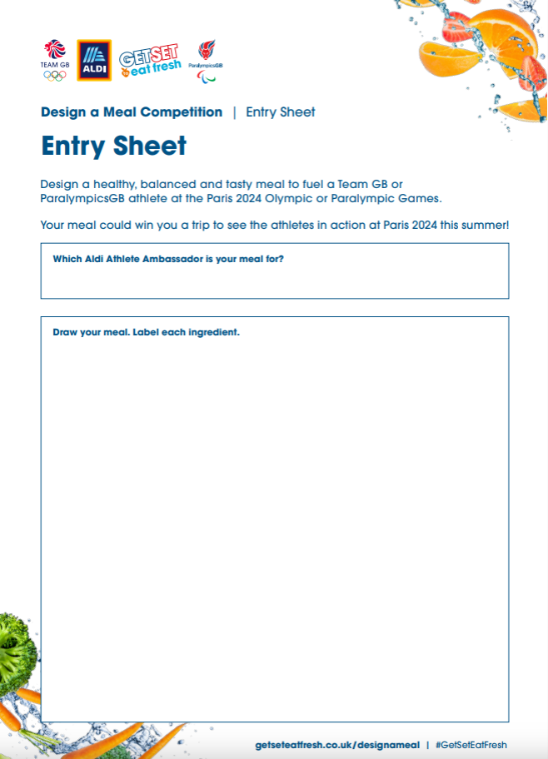
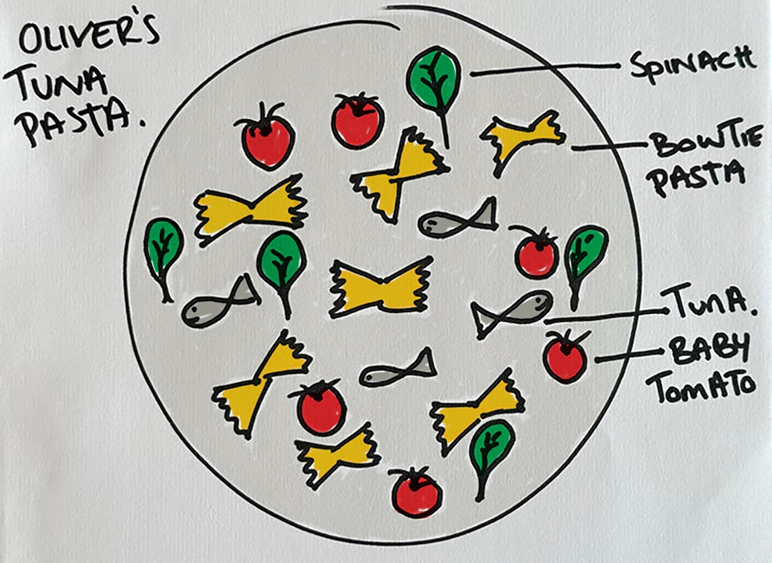
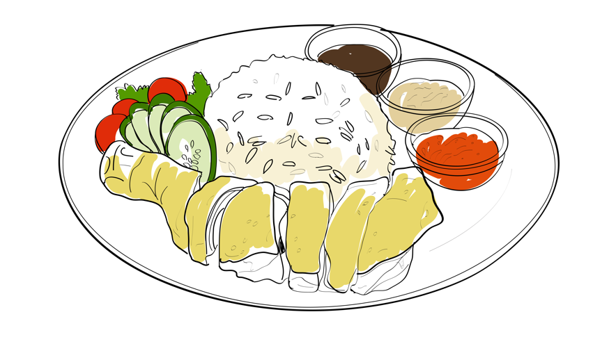
Draw and label your meal idea
Draw your meal on the entry sheet.
Show us how much of each ingredient you'll include.
Label each part of your meal.
Make your meal look as
tasty as you can!
Delicious Orie
Salad, cucumber, tomatoes, spinach and coriander
Glass of water with cucumber!
Boiled rice
Large portion of steamed chicken
Spicy tomato sauce, low salt soy sauce
Notes:
Review p1 of the entry template.
Support: Print or display the support sheets on slides 24 and 25.
Discuss how students can draw their meal and label it to show what it includes. For example:
How can they divide the plate into segments to show the right amount of carbohydrates (starchy foods), protein and vegetables or fruits?
How can they show the most important parts of their meal and also label smaller components like sauces or herbs and spices that make it interesting and tasty?
Encourage pupils to use colour to bring their meal to life, and to include as many labels as they can.
You may also want to provide reference materials to help students research meal ideas, for example some food images, cookbooks or access to online recipes.

Slide 16
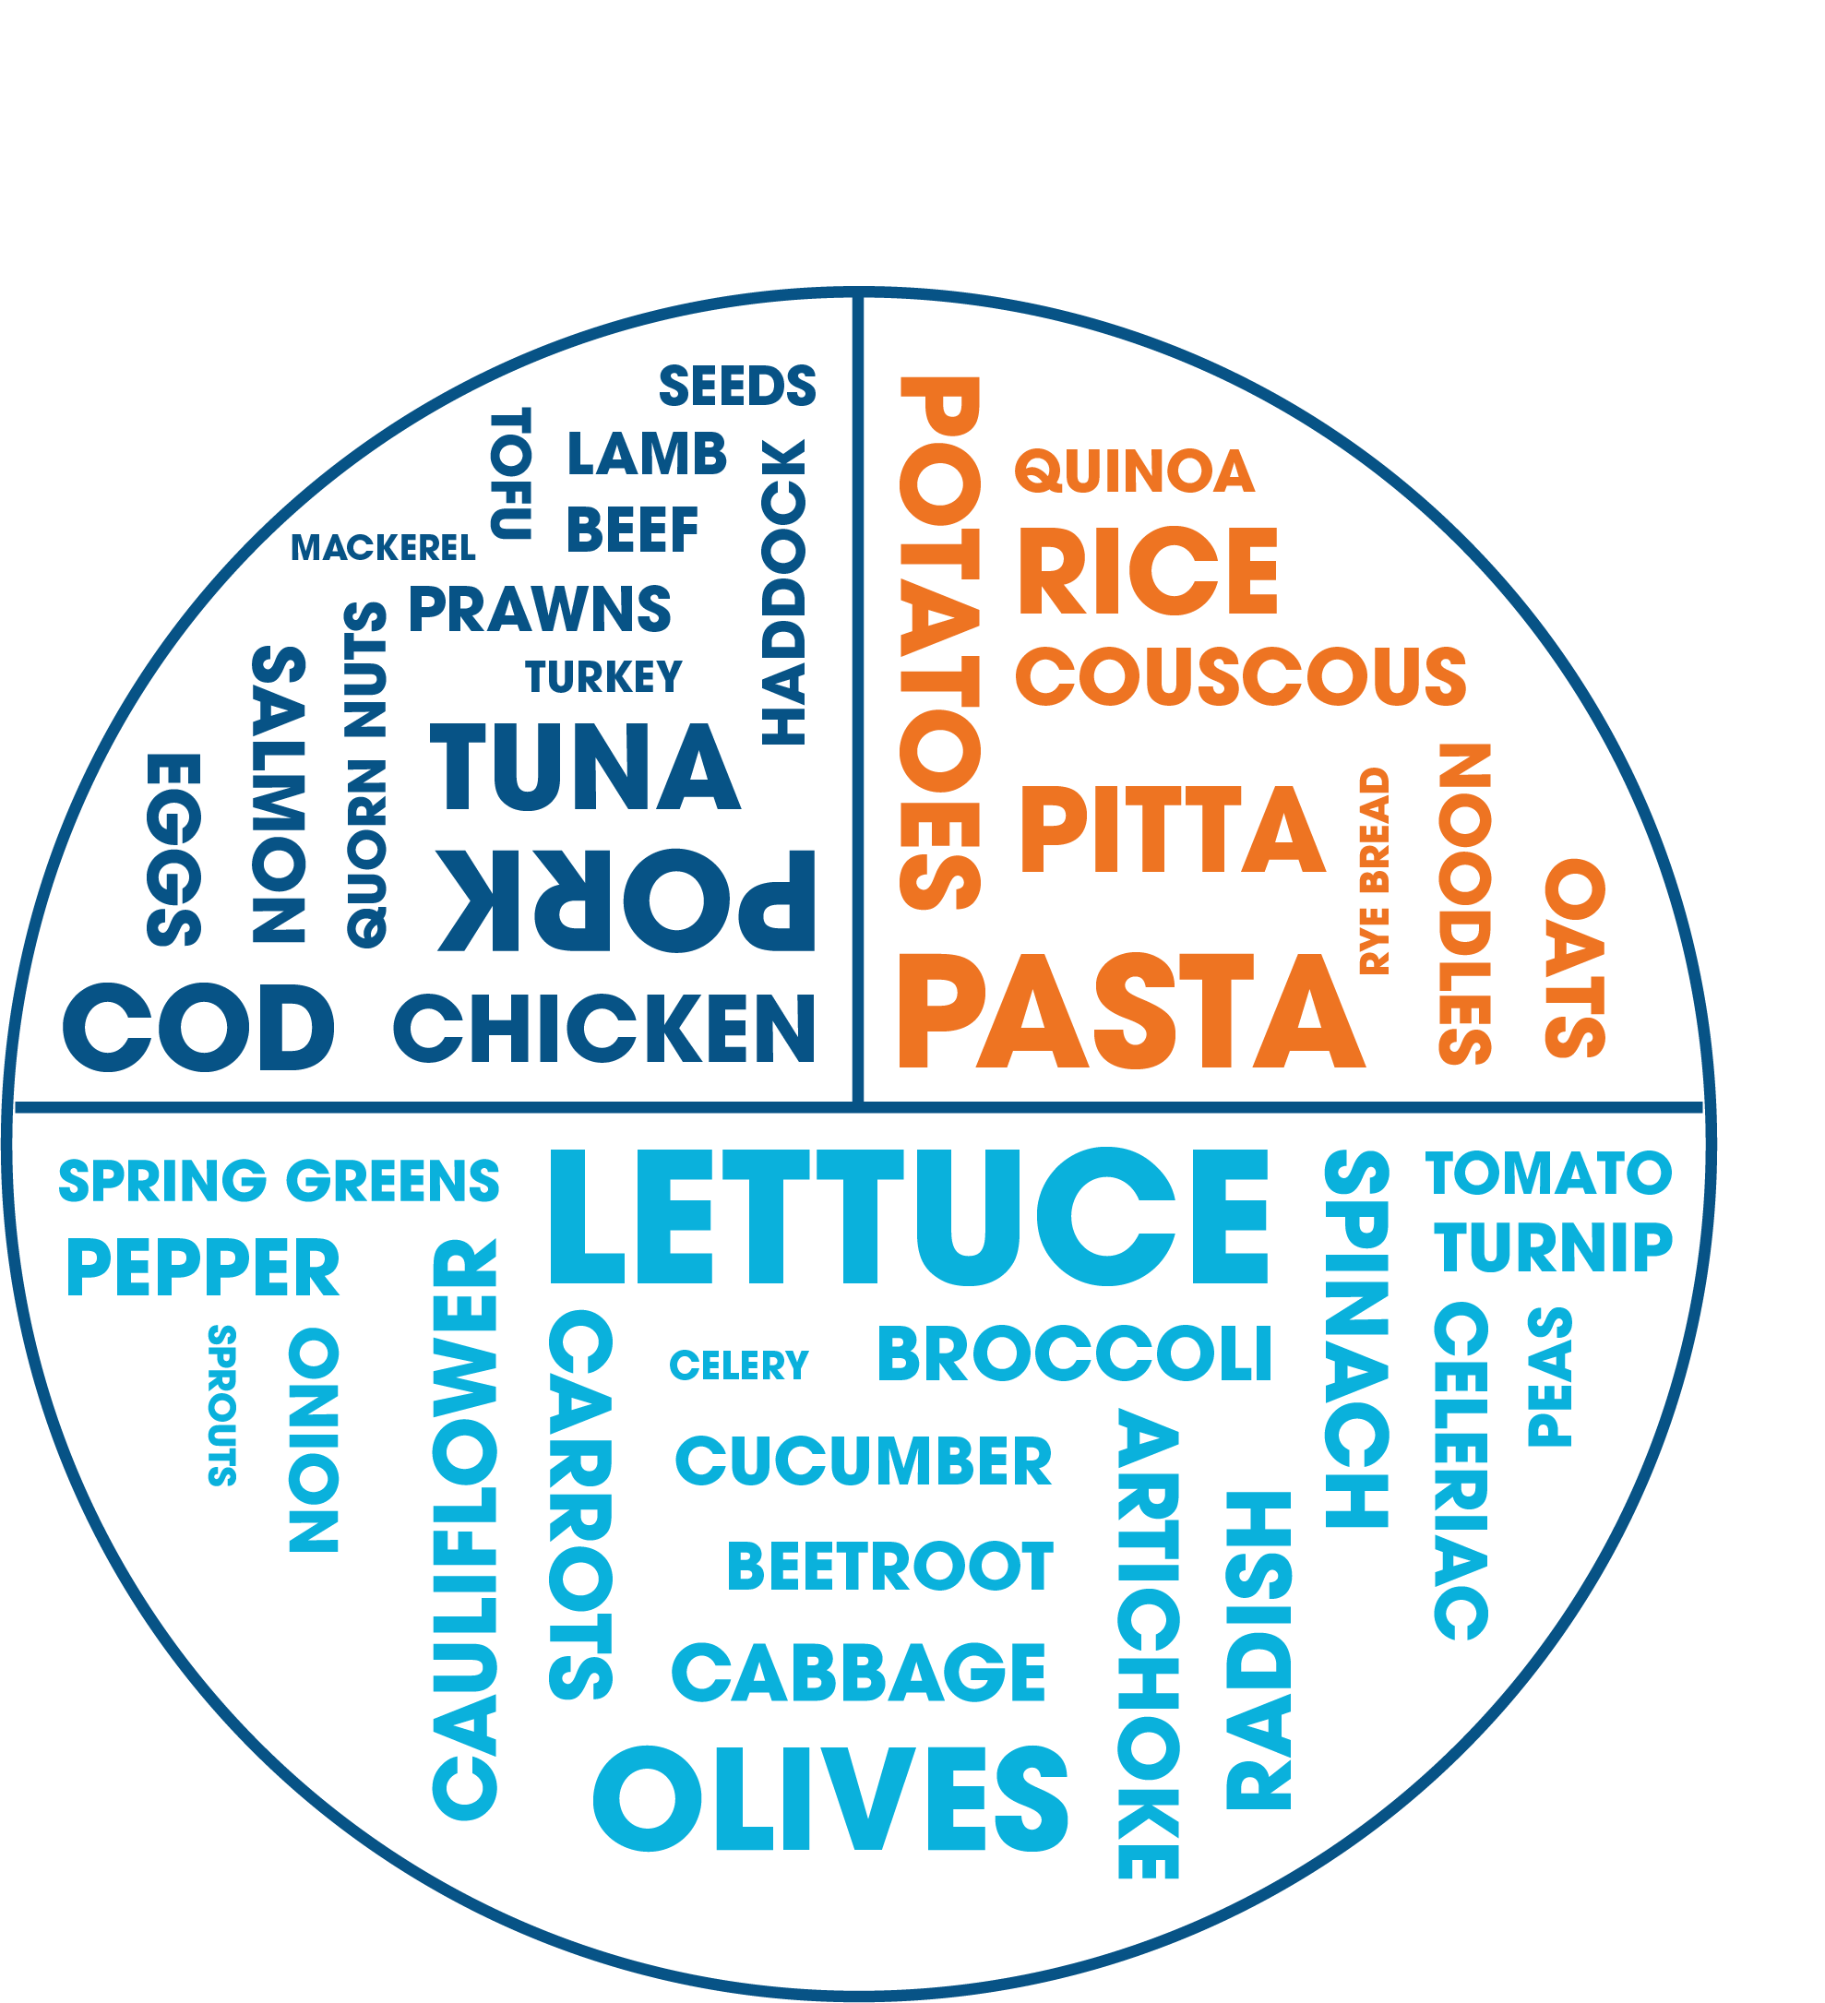
Tell us why your meal is healthy and balanced
How have you included a balance of food groups?
Have you included a variety of fruits and vegetables
of different colours?
Have you included a drink to keep hydrated?
How does your meal suit your athlete?
When will they eat it? Why is it good for this time?
Does it have enough of the foods they need?
Does it suit your athlete's taste?
How will it help them perform their best?
Notes:
Review side 2 of the entry template. There are two parts to this: that it is healthy and balanced, and that it takes into account the athlete's needs.
Support: Remind students that some athletes might need more of some nutrients than an average person, like more carbohydrates or protein. Every athlete needs to eat plenty of fruits and vegetables!
Challenge: Ask students to think about how they can explain how their meal is low in fats, salt or sugar. What types of carbohydrates have they included – how does this suit the time of day?

Slide 17
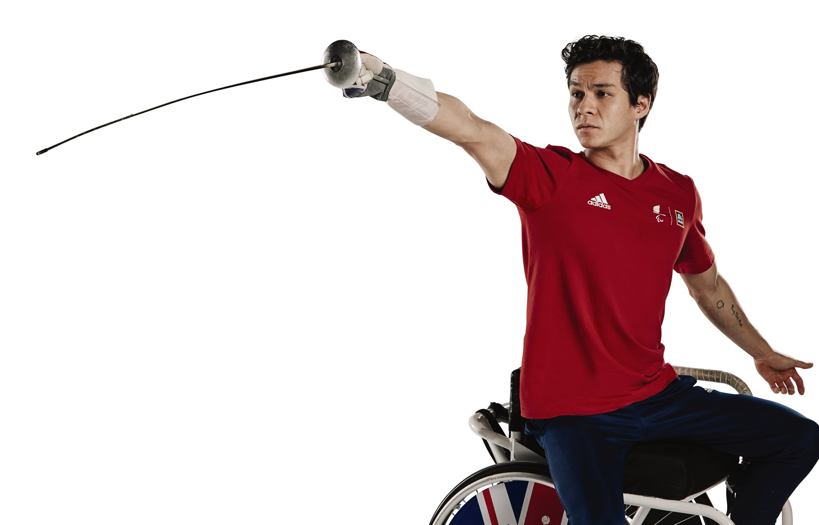
Judging criteria
The judging panel are looking for meal ideas
that are:
clearly presented
– well drawn and labelled
healthy and balanced
– with a range of ingredients
well suited to your chosen athlete
– matching their needs and / or tastes
and helping them perform their best
tasty and creative!
Make sure your entry explains these things well!
getseteatfresh.co.uk | #GetSetEatFresh
Notes:
Judging criteria
Share the competition judging criteria with the class. Encourage students to think through their initial ideas and get ready to create their final meal design!
Support: Ask students to create a list of things to bear in mind when creating their final design.
Examples:
Practising their final design before putting it onto the template.
Creating a clear design on the plate, with all ingredients easy to see.
Using pens / materials clearly and making sure they make a clear mark on the page.
Using photos as reference to help draw foods.
Practising writing on other paper to check spelling first.
Remembering to take time to draw and label their plate, and to explain their choices on the second side.

Slide 18
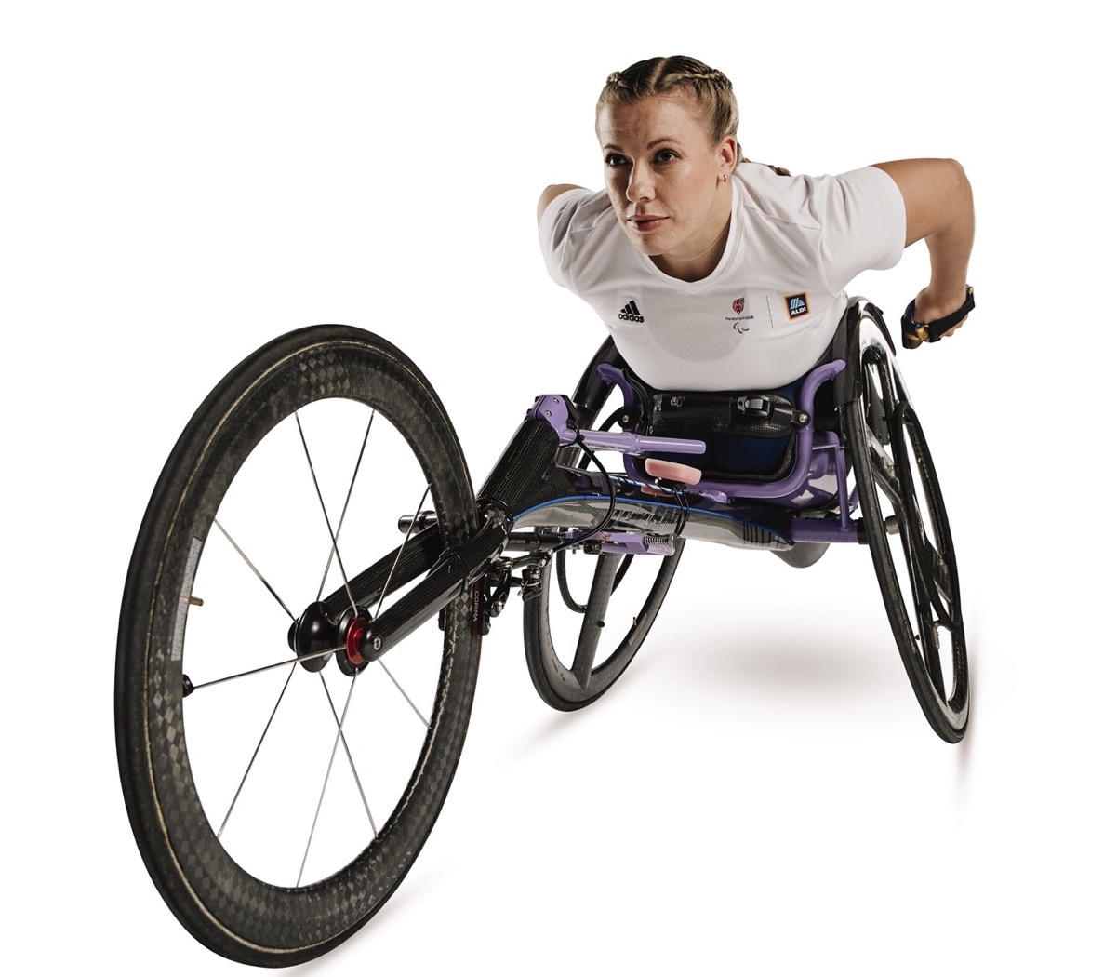
How to enter
Once you have decided on your meal:
draw your meal clearly and neatly
on to the entry template
don't forget to label each ingredient
on the second page, explain why your meal
is healthy, tasty and right for your athlete
enter your personal details on
the second page
return your completed entry to your teacher.
Notes:
Enter the competition
If you are not completing the final meals designs in class time, you may wish to add a date to this slide by which students should return their entry to you.
If you are setting the design as homework, you may wish to download and complete the Parents letter document, to ensure entries are returned in time, and provide copies of the Parent guide which outlines the components of a healthy, balanced diet.
Please send all your students’ entries, together with the cover sheet for entries, by Friday 10 May 2024. Entries received after this date will not be accepted. Submission of entries also requires acceptance of Terms and Conditions. For more information, and to download the entry template and cover sheet for entries, please visit: getseteatfresh.co.uk/designameal
Why not share your classes designs to inspire other people to get involved with the competition? Submit a showcase on the GSTEF community page or tweet @AldiUK, @TeamGB and @ParalympicsGB using #GetSetEatFresh. Ensure all sharing is in line with your school’s safeguarding procedures (i.e. obscure student details from images) before posting.

Slide 19
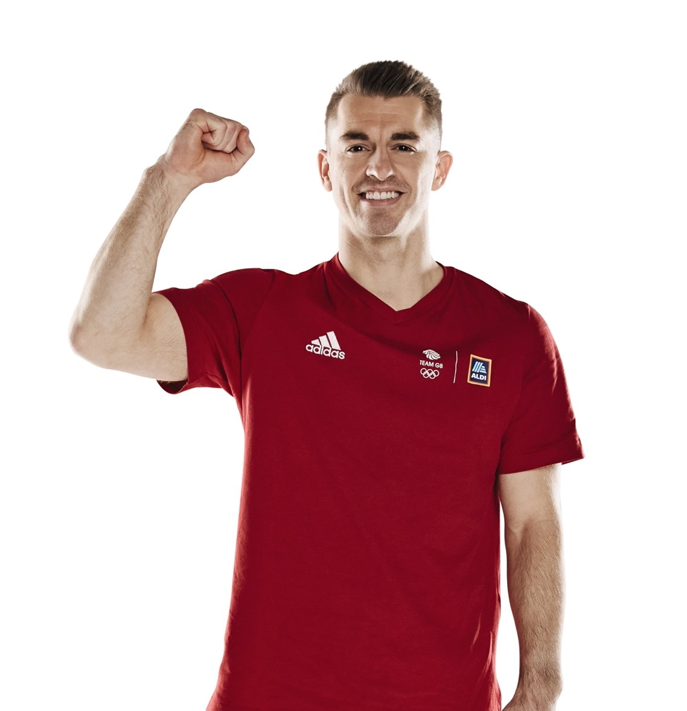
Be inspired!
Thanks for choosing to design a meal for a Team GB or ParalympicsGB athlete – and good luck!
Healthy, balanced meals aren't just for athletes – we all need a balanced diet
to stay healthy and well.
What have you learned today about a healthy, balanced diet?
What will you do to make your diet healthy, balanced – and tasty?
getseteatfresh.co.uk | #GetSetEatFresh
Notes:
Finish by reminding students that we can all be inspired by these ideas and make sure we all enjoy a healthy, balanced diet.
Encourage younger pupils to think of something they can ask a parent or carer to help them do, or that they can do as part of your school lunch provision (for example trying the vegetables in a meal rather than leaving them).
Emphasise that a healthier diet doesn't need to be expensive. We can choose a piece of fruit instead of a sugary snack, choose just to snack less, try a cheaper alternative to meat like beans or lentils or a wholegrain alternative to white pasta or bread. (Perhaps older students could help with cooking at home!)
Encourage each student to share:
One helpful thing they have learned
One step they could take to enjoy a healthy, balanced diet themselves.
Support: For example, students might:
Choose to eat fewer salty or sugary snacks like fizzy drinks, sweets or crisps, instead exploring low sugar and fat snacks such as fruits, vegetables/chopped vegetables and low-fat hummus, a crumpet, malt loaf, bread/toast with low-fat spread, a yoghurt, plain popcorn or rice cakes.
Try a new vegetable or fruit.
Try to 'eat the rainbow' and ask to eat fruits and vegetables of different colours each day
Try a different healthy source of protein like beans or lentils.
Try a healthier carbohydrate, like wholemeal pasta or bread, brown rice, or eating potato skins as well as the middle.

Slide 20
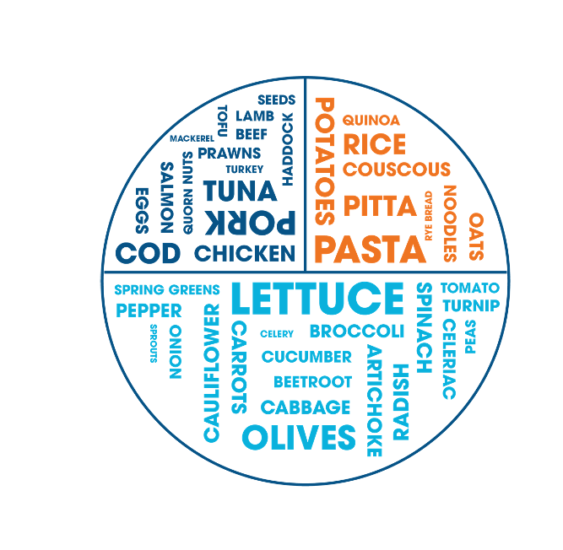
Design a meal planning ideas
Not sure where to start?
Circle a protein and carbohydrate then choose some vegetables to go with them!​
Protein
Beef Beans Lentils
Chicken Salmon Cod
Lamb Nuts Seeds
Pork Eggs Mackerel
Turkey Quorn Tofu
Carbohydrates
Choose whole grain or skin-on versions!
Pasta Potatoes Rice
Bread Wraps Pitta
Noodles Chapatis Grains
Couscous Quinoa Sweet potato or yam
Vegetables
Eat the rainbow! Choose at least three vegetables of different colours.
Peas Onion Carrot Broccoli Cauliflower Aubergine Cabbage Kale Celeriac Fennel Lettuce Watercress Rocket Mushrooms Peppers Cucumber Tomato Olives Celery Spinach Beetroot Sweetcorn Beansprouts Okra Courgette Asparagus Garlic Ginger Chillies Squash Parsnip Turnip Brussels sprouts Swede
Now add flavour!
What herbs, spices or sauces will make your meal tasty and creative?
Notes:
Print or display this slide to support students.
This slide summarises healthy meal ingredients to help students plan their meal.

Slide 21
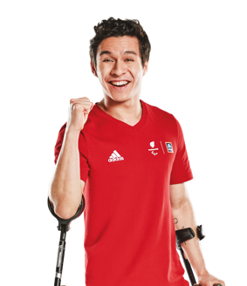
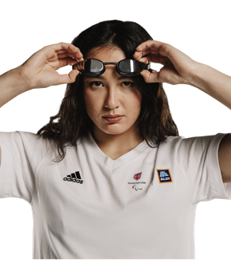
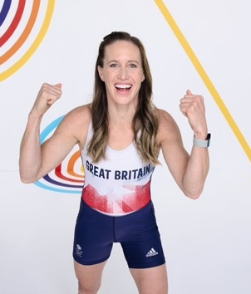
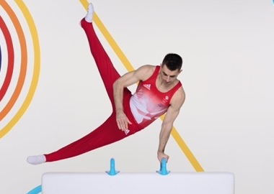
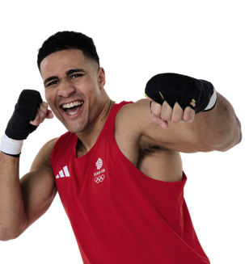
Meet the athletes
All athletes need a meal that includes carbohydrates, protein and vegetables and a drink. Find your athlete's other likes and needs.
Athlete name | Sport | Food favourites and food needs
Helen Glover | Rowing | Carrots and spinach.
Oliver Lam-Watson | Para Fencing | Aubergine, radishes and sushi!
Max Whitlock | Gymnastics | Pasta with meat and vegetables.
Alice Tai | Para Swimming | I'm vegetarian so need beans and lentils for protein.
Delicious Orie | Boxing | Eggs, chicken, salmon, rice and avocados!
Notes:
Print or display this slide to support students.
Support: use this simplified versions of the athlete profiles to support students.

Slide 22
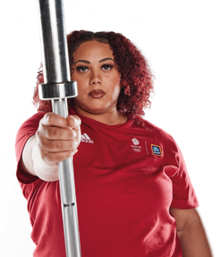
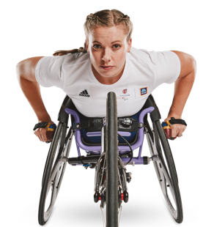
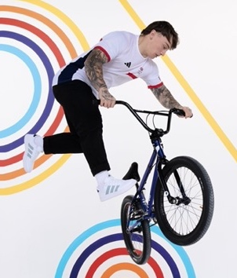
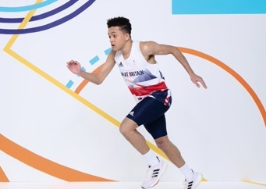
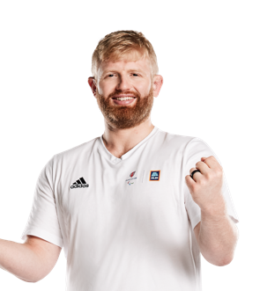
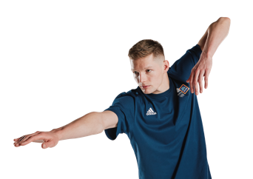
Meet the athletes
All athletes need a meal that includes carbohydrates, protein and vegetables and a drink. Find your athlete's other likes and needs.
Athlete name | Sport | Food favourites and food needs
Thomas Young | Para Athletics | I love broccoli, rice and chicken, but I'm allergic to cheese.
Hannah Cockcroft | Para Athletics | Everything except fish!
Duncan Scott | Swimming | Lasagne (and scrambled eggs for breakfast)!
Emily Campbell | Weightlifting | Variety! Noodles, grilled chicken burgers, rice and plantain...
Chris Skelley | Para Judo | I'm gluten-free (no wheat), but love pasta, veg and meat!
Kieran Reilly | Freestyle BMX | Mexican food!
Notes:
Print or display this slide to support students.
Support: use this simplified versions of the athlete profiles to support students.

Slide 23
Design a meal planning ideas
Use the example ingredient and meal ideas to start planning your athlete's meal.
Protein
Carbohydrates
Vegetables
Meal ideas
Chicken
Salmon
Potatoes
Rice
Carrots
Peppers
Falafel couscous salad
Prawn noodles
Burrito bowl
Eggs
Tofu
Pasta
Noodles
Spinach
Tomato
Veggie chilli
Lasagna
Lentil curry
Beans
Lentils
Plantain
Bread
Broccoli
Avocado
Overnight oats
Fruit salad
Chicken pasta
Notes:
Print or display this slide to support students.
Support: use these ingredient and meal ideas to support students in their planning.

Slide 24
A healthy, balanced diet helps you feel your best
A healthy diet includes a wide variety of foods, in the right proportions and amounts for our needs:
Enjoy at least five portions of fruits and vegetables a day, which can be fresh, frozen, tinned, dried or juiced.
Aim to 'eat the rainbow' and include fruits and vegetables of every colour.
Choose high fibre, whole carbohydrates like wholemeal bread, brown rice, wholemeal pasta or potatoes with the skin on.
Include a source of healthy protein in each meal, like lean meat, fish, eggs, beans and pulses, or tofu.
Include healthy fats and oils, but not too much.
Avoid foods that are high in saturated fat,
salt or sugar, and processed meats.
For more information, please visit https://www.nhs.uk/live-well/eat-well/how-to-eat-a-balanced-diet/eating-a-balanced-diet/
When we plan a meal, an healthy plate for an average adult should include about half vegetables, a quarter protein and a quarter carbohydrates:
Source: https://www.uhsussex.nhs.uk/
resources/food-fact-healthy-portions-plate/
Notes:
Print this slide to support students in planning their meals.
This slide summarises healthy diet guidance to help you deliver the lesson.

Slide 25
Design a healthy, balanced meal to fuel a Team GB or ParalympicsGB athlete at Paris 2024.
Parent guide
Your child is going to help a Team GB or ParalympicsGB athlete by designing a healthy, balanced meal for them to enjoy! Here's how to help them create a strong entry.
Choose an athlete
Your child needs to choose one Aldi Athlete Ambassador who will eat their meal. Every athlete has some likes and needs.
Design a tasty, healthy meal
Be creative! Help your athlete to enjoy a meal that's not only healthy, but also tasty and fun to eat.
Once your child has decided on their meal, they should:
draw their meal clearly and neatly on to the entry template.​
remember to label each ingredient​
on the second page, explain why their meal is healthy and balanced and right for their athlete​
write their personal details on the second page​
return their completed entry to their teacher.
Thank you for supporting your child but please remember their entry should be all their own work!
What's in a healthy diet?
A healthy diet includes a wide variety of foods, in the right proportions and amounts for our needs:
Enjoy at least five portions of fruits and vegetables a day, which can be fresh, frozen, tinned, dried or juiced.
Aim to 'eat the rainbow' and include fruits and vegetables of every colour.
Choose high fibre, whole carbohydrates like wholemeal bread, brown rice, wholemeal pasta or potatoes with the skin on.
Include a source of healthy protein in each meal, like lean meat, fish, eggs, beans and pulses, or tofu.
Include healthy fats and oils, but not too much.
Avoid foods that are high in saturated fat, salt or sugar, and processed meats.
Includes amounts of foods well suited to your activity levels (so an athlete may need more protein and carbohydrates).
For more information, please visit https://www.nhs.uk/live-well/eat-well/how-to-eat-a-balanced-diet/eating-a-balanced-diet/
What's on a healthy plate?
When we plan a meal, a healthy plate for an average adult
should include about half vegetables, a quarter protein and a quarter carbohydrates:
Source: https://www.uhsussex.nhs.uk/resources/food-fact-healthy-portions-plate/
Notes:
Print this slide to provide parents with top tips to support their child in completing their entry at home.

